Slide 1

Notes:
Good morning, everyone. Today, we are addressing one of the most critical yet frequently overlooked challenges in financial planning: the psychological transition from wealth accumulation to joyful decumulation.
For decades, the financial industry has concentrated almost exclusively on the math of saving—how to build a nest egg, maximize 401(k) contributions, and chase portfolio returns.
However, as personal finance leader Jean Chatzky highlights in her recent work, having a full bank account does not automatically translate into a fulfilling retirement if you are plagued by a constant fear of spending.
Over the next 15 slides, we will explore why moving from asset growth to creating a guaranteed 'Forever Paycheck' is essential for unlocking the permission to actually enjoy the money you've spent a lifetime saving.
https://www.youtube.com/watch?v=YfPlcduQQ9w

Slide 2
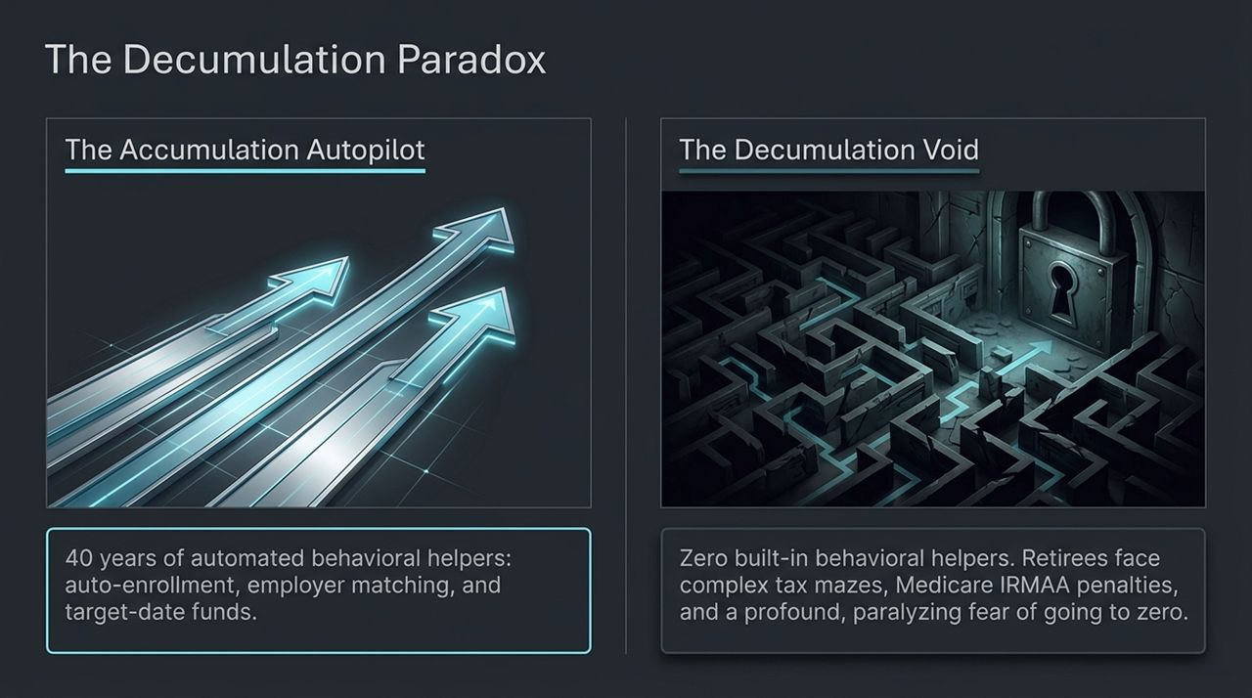
Notes:
To understand why spending money in retirement is so difficult, we have to look at the behavioral system we’ve built over the last 40 years.
During our working years, we operate on Accumulation Autopilot. The system is loaded with behavioral helpers: default auto-enrollment in retirement plans, target-date funds that automatically rebalance risk, and employer matching programs.
Then comes retirement, and retirees suddenly tumble into The Decumulation Void. Overnight, every single automated system turns off.
Instead of automated guardrails, retirees are suddenly thrust into a maze of tax brackets, Medicare IRMAA surcharges, required minimum distributions (RMDs), and an overwhelming fear of outliving their assets.
As Jean Chatzky points out, 'While we have these behavioral finance helpers built into accumulation... none of that stuff exists for spending.'

Slide 3
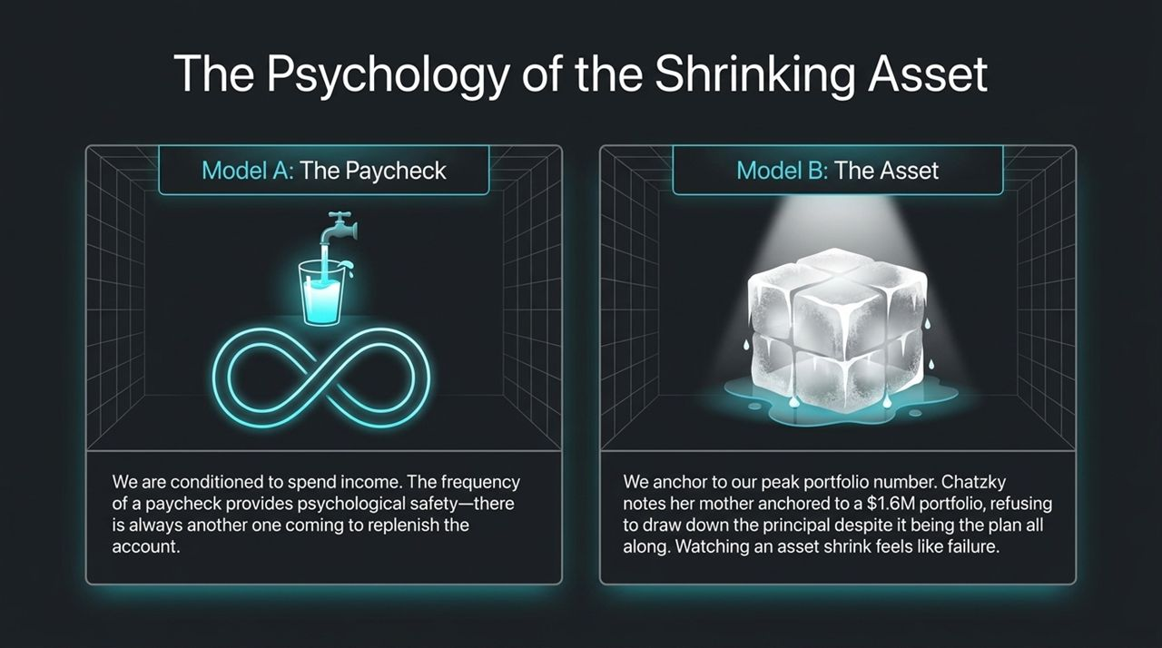
Notes:
Why do retirees struggle so much to pull money out of standard brokerage or retirement accounts?
It comes down to mental accounting. Under Model A (The Paycheck), we spend income naturally. A recurring paycheck creates psychological security because we know another payment arrives in two weeks to replenish the balance.
Under Model B (The Asset), we view a nest egg as a static block—a melting ice cube. Most retirees anchor emotionally to their peak net-worth figure.
Jean Chatzky shares a personal story about her mother: Her mother inherited a $1.6M portfolio, had pensions and Social Security, yet refused to touch a single dollar of the $1.6M principal because watching that asset shrink felt like failure.
When she passed away 20 years later, she still had over $1.6 million. Watching a fixed balance drop creates friction and anxiety, even when spending down principal was the intent all along.

Slide 4
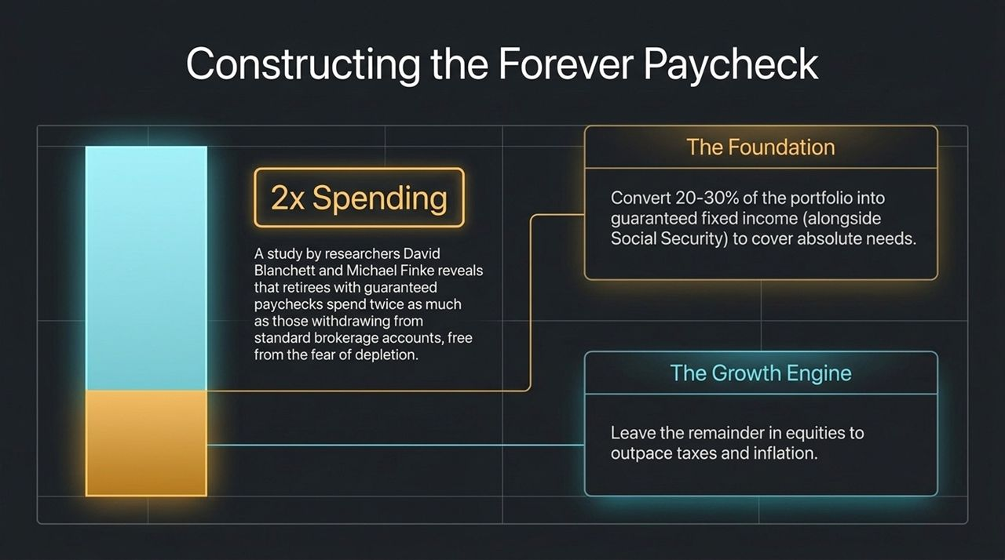
Notes:
How do we overcome this fear? Research by David Blanchett and Michael Finke reveals a striking finding: retirees with guaranteed income streams (paychecks) spend twice as much as those with equal wealth stored in standard brokerage accounts.
Because guaranteed income provides psychological permission to spend, we structure the portfolio into two core components:
1. The Foundation: Allocate 20% to 30% of total portfolio assets into guaranteed fixed income (alongside Social Security). This creates an income floor covering non-negotiable living costs.
2. The Growth Engine: Leave the remaining 70% to 80% invested in equities to hedge against long-term inflation and taxes.
By converting a portion of assets into guaranteed lifetime paychecks, retirees eliminate the fear of asset depletion and freely enjoy their lifestyle.

Slide 5
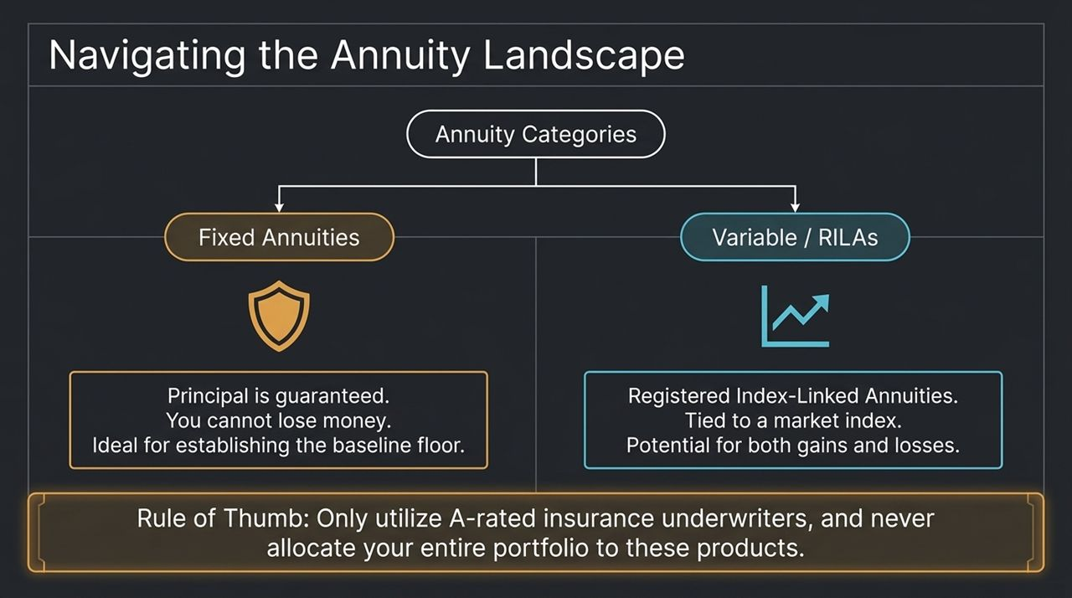
Notes:
When considering annuities to establish this baseline floor, it’s vital to understand product categories and avoid missteps.
Fixed Annuities: These provide principal protection. You cannot lose money due to market fluctuations, making them ideal for building a predictable income floor.
Variable / RILAs (Registered Index-Linked Annuities): These are tied to market indices, offering growth upside but exposing principal to potential loss.
Golden Rules for Implementation:
Never allocate your entire net worth into an annuity—stick to the 20-30% rule for fixed needs.
Only use top-rated insurance underwriters (rated 'A' or higher by rating agencies).
Always ask advisors about product transparency and underlying assets.

Slide 6
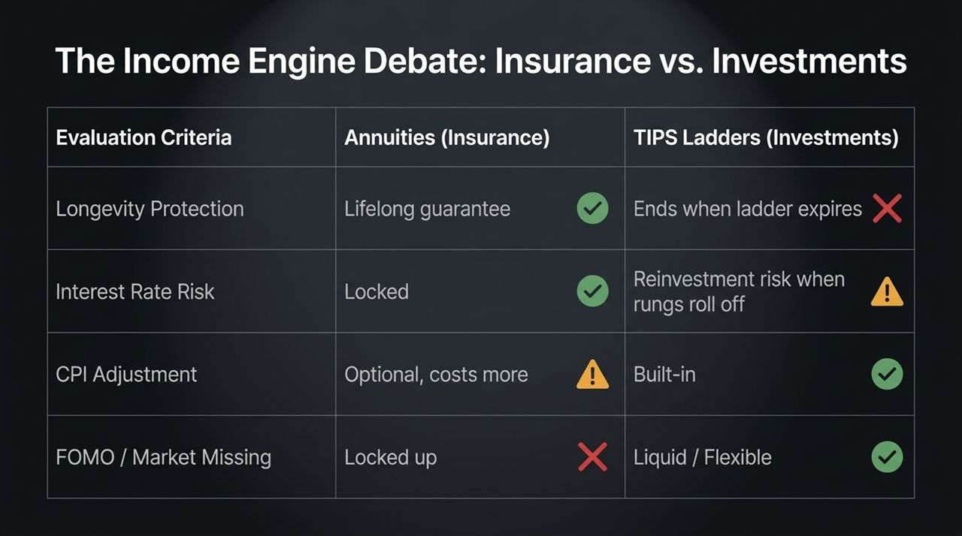
Notes:
A common question from index investors is: Why buy an annuity when I can build a Treasury Inflation-Protected Securities (TIPS) ladder?
Let's compare these two approaches across key criteria:
Longevity Risk: TIPS ladders offer no lifetime guarantee; payments stop when the ladder ends. Annuities provide lifelong income regardless of how long you live.
Interest Rate Risk: TIPS face reinvestment risk as individual bond rungs mature. Fixed annuities lock in payout rates at purchase.
Psychology & FOMO: TIPS remain liquid, whereas annuities lock up capital. If you suffer from FOMO when equity markets perform well, a pure total return or investment-ladder strategy may better suit your personality.

Slide 7
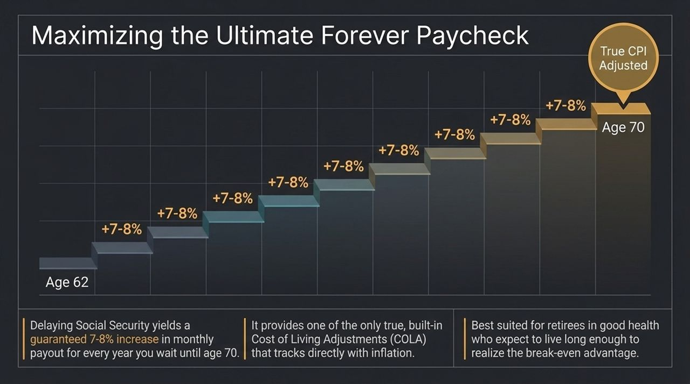
Notes:
Before purchasing commercial financial products, maximize your primary built-in annuity: Social Security.
Claiming at age 62 permanently reduces your benefit baseline. Delaying past full retirement age yields a guaranteed 7% to 8% annual increase in payout for every year delayed up to age 70.
Social Security provides an inflation-adjusted pension backed by the federal government, featuring true CPI-based Cost-of-Living Adjustments (COLA).
For clients in reasonably good health expecting average or above-average longevity, delaying Social Security to age 70 serves as the foundation of an effective decumulation plan.

Slide 8
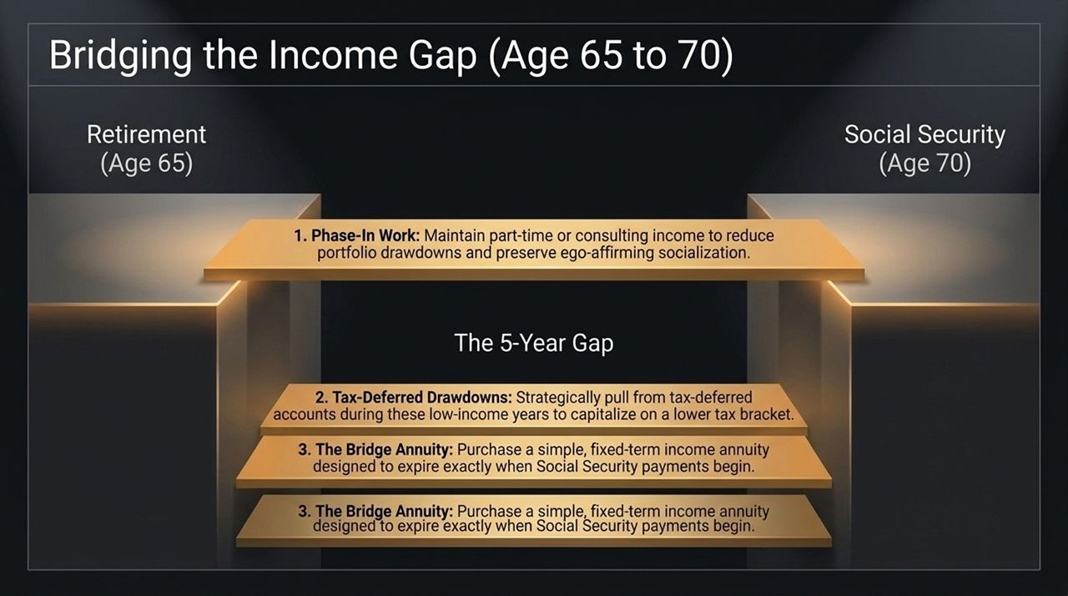
Notes:
If delaying Social Security to age 70 is ideal, how do retirees cover expenses during the 5-year gap after stopping work at age 65?
Here are three practical bridging strategies:
1. Phased-In Work: Transition into part-time work or consulting. Generating modest earned income reduces portfolio draws while maintaining social connections.
2. Tax-Deferred Account Drawdowns: Strategic withdrawals from traditional IRAs or 401(k)s during lower-income gap years can be taxed at lower rates before RMDs begin.
3. The Bridge Annuity: Purchase a short-term, fixed-period annuity structured to pay income for exactly 5 years, terminating when Social Security begins.

Slide 9
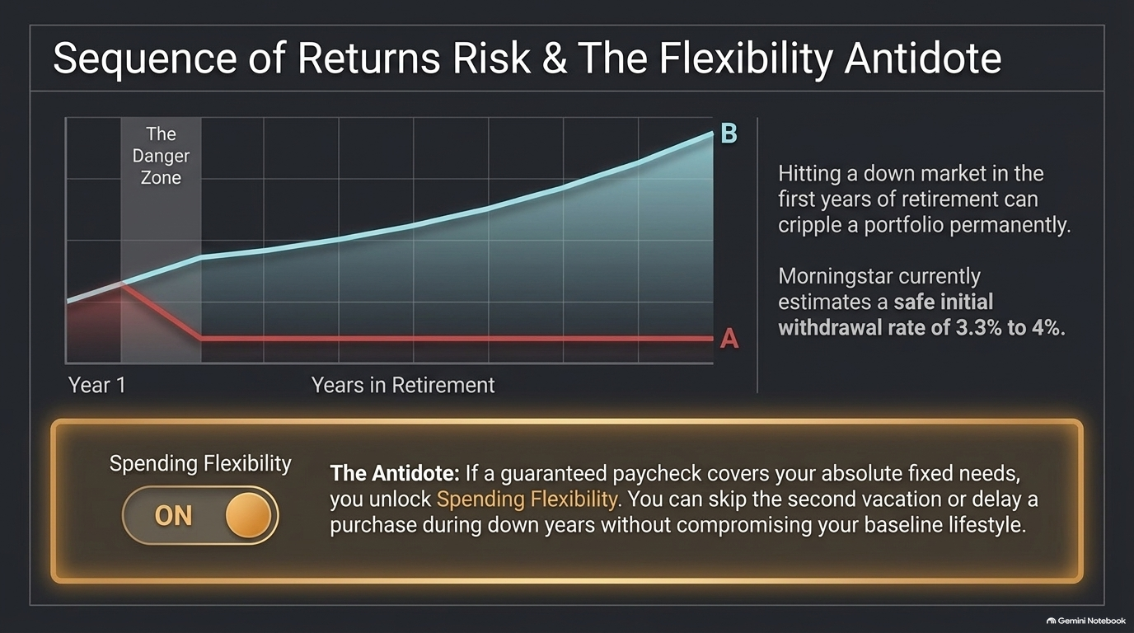
Notes:
Sequence of Returns Risk is a major threat in early retirement. Experiencing a market downturn during years 1–3 forces you to sell depreciated assets to fund living expenses, permanently impairing portfolio longevity.
Morningstar estimates safe initial withdrawal rates around 3.3% to 4.0% under static models.
The Antidote: Dynamic Spending Flexibility.
When your baseline needs are fully covered by guaranteed paychecks, you gain total flexibility over discretionary spending.
During market downturns, you can easily reduce discretionary travel or delay major purchases without compromising your core lifestyle or selling equities at bottom prices.

Slide 10

Notes:
Financial security is useless if partners lack alignment on how daily life will look.
Research indicates that only 6 in 10 couples share a common vision for life in retirement.
Jean Chatzky highlights a Wall Street Journal case study where one partner wanted to travel the world, while the other wanted to walk to the local library and watch baseball games.
The Solution: Divide & Conquer. Couples do not need to spend every hour together in retirement. Granting each other permission to pursue independent hobbies and trips preserves marital harmony and individual identity.

Slide 11
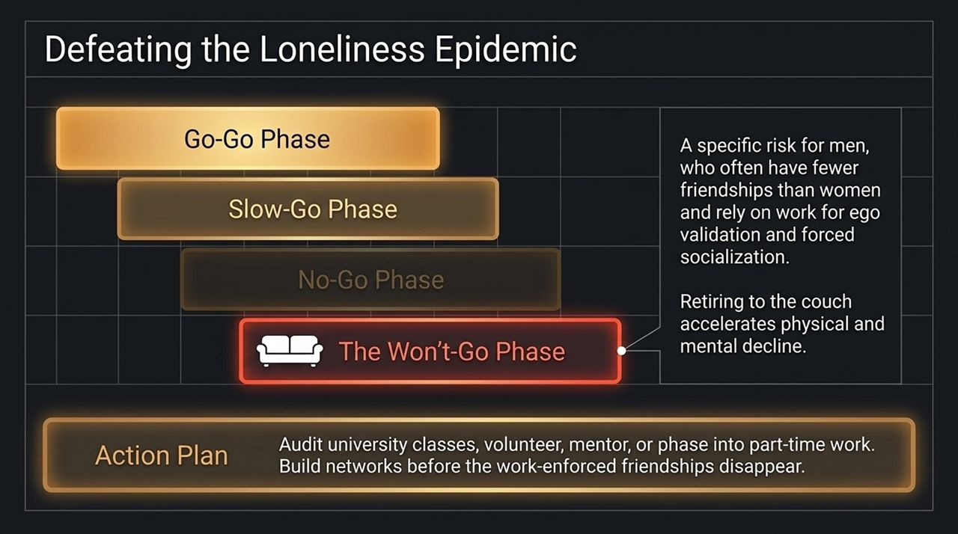
Notes:
Retirement progresses through three main phases: Go-Go, Slow-Go, and No-Go. However, experts identify a fourth trap: the 'Won't-Go' Phase.
This risk disproportionately affects men, who frequently rely on workplace structures for social networks and validation.
Retiring to the couch leads to rapid physical, emotional, and cognitive decline.
Actionable Steps: Before retiring, build social connections outside of work—audit university courses, volunteer, join clubs, or transition through part-time work to maintain purpose.

Slide 12
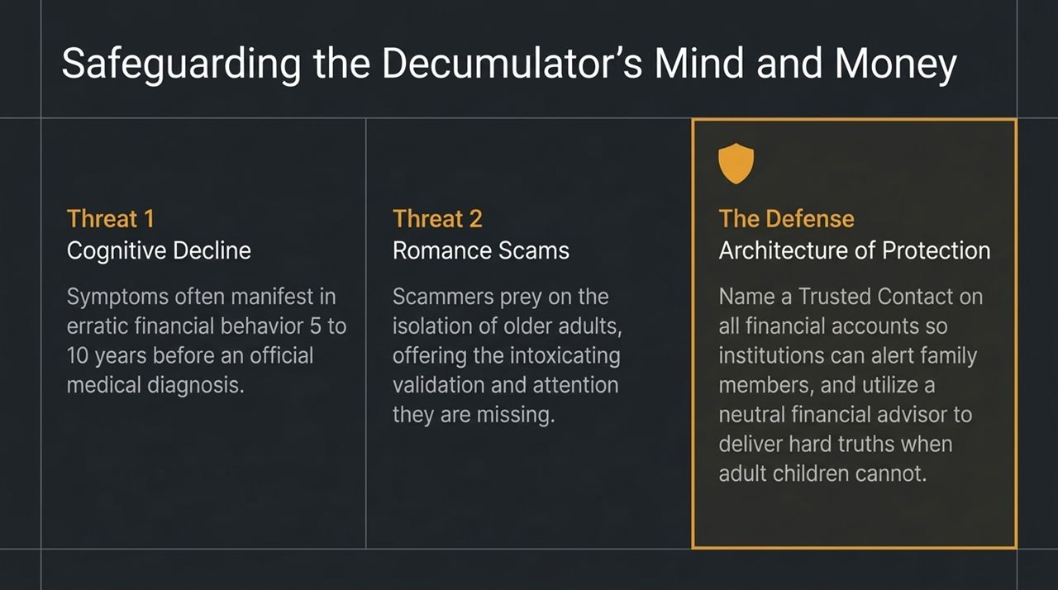
Notes:
As decumulators age, we must protect both their mental health and financial security against two significant threats:
1. Cognitive Decline: Financial decision-making capabilities often drop 5 to 10 years before a formal clinical diagnosis of dementia occurs.
2. Romance & Isolation Scams: Bad actors prey on isolated seniors, offering emotional validation to extract money.
The Defense Architecture:
Establish a Trusted Contact on all financial accounts so custodians can alert loved ones to unusual activity.
Work with a neutral financial advisor who can deliver objective guidance when family discussions become difficult.

Slide 13
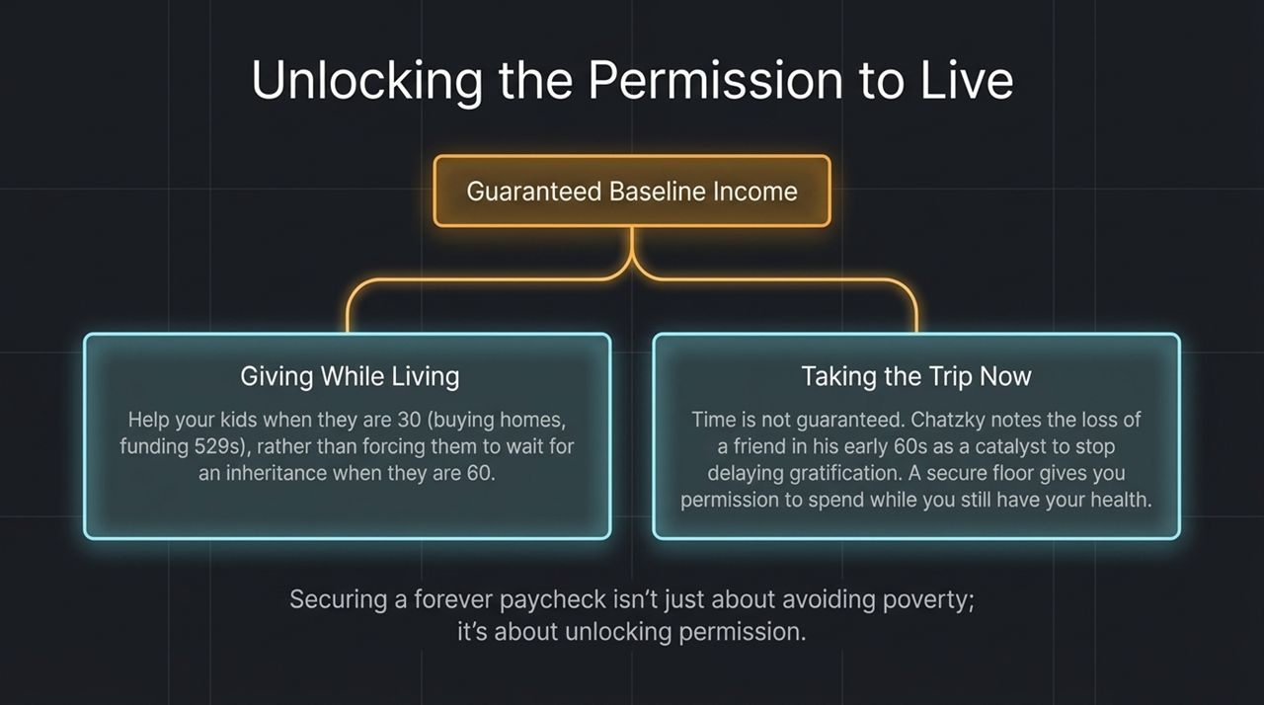
Notes:
The ultimate goal of securing a Forever Paycheck isn't just avoiding poverty—it's unlocking permission to enjoy life.
Giving While Living: With guaranteed baseline expenses covered, you can comfortably assist adult children when they need it most (e.g., home down payments or 529 funds at age 30) rather than passing down an inheritance at age 60.
Taking the Trip Now: Health and time are finite. Jean Chatzky notes how losing a close friend in his early 60s served as a reminder to stop postponing travel and experiences.
Guaranteed income provides the psychological freedom to spend without guilt or worry.

Slide 14

Notes:
Here is the step-by-step blueprint to implement this strategy:
1. Calculate the Floor: Sum up all non-negotiable living expenses (housing, healthcare/Medicare, food, baseline maintenance).
2. Secure the Baseline: Delay Social Security toward age 70 to maximize CPI-adjusted income, and allocate 20–30% of assets toward fixed annuities or TIPS to cover the remaining floor gap.
3. Align the Vision: Have an open 'Maine vs. Florida' discussion with your spouse, establishing shared and individual goals.
4. Install Safeguards: Name trusted contacts across all financial accounts, maintain social networks, and establish phased purpose before leaving the workforce.

Slide 15

Notes:
To wrap up our deck, let's review the integrated model for decumulation success:
Break free from the Accumulation Trap: Recognize that shifting from saving to spending is primarily a psychological challenge.
Leverage the 2X Spending Effect: Structure 20–30% of your net worth into lifetime income streams to double your effective lifestyle spending safely.
Maximize Age-70 Benefits & Maintain Spending Flexibility: Pair maximized Social Security with dynamic 3.3%–4.0% withdrawal rates on your growth equity bucket.
By implementing this dual approach, you protect your principal against market downturns while gaining total freedom to spend with confidence throughout retirement.

